Slide 1

Guidelines for Classification of Waters According to the LBS Protocol
Seventh Meeting of the Scientific and Technical Advisory Committee of the Protocol Concerning Pollution from Land-Based Sources and Activities (7th LBS STAC)
Maurice Narcis, PhD
Institute of Marine Affairs
22nd July, 2025

Slide 2
Summary
Background
Methodology
Water Classification
Existing Water Classification in the WCR
External Example
Proposed Guidelines
Recommendations

Slide 3
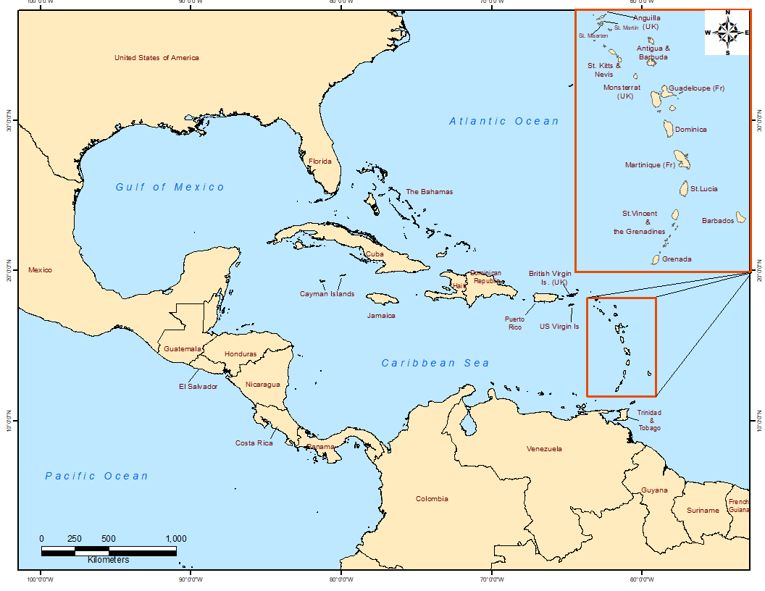

Slide 4
Background
SSFA Project Activity - Develop Guidelines for classification of waters according to the LBS Protocol with support by RAC CIMAB
  Questionnaire to countries on water classification systems.
  A literature review on water classification systems used globally.
  A review on water classification system according to the LBS Protocol implemented in the WCR
  Sub-regional report received from RAC CIMAB based on questionnaire responses from Spanish Speaking countries on water classification system and implemented according to the LBS Protocol.
  Integration of sub regional reports the results of both reports (sub-regional studies) and preparation of the final report

Slide 5
Background
Twenty (20) countries assessed – 10 English Speaking and 10 Spanish Speaking countries
Questionnaire designed by both RACs was circulated to respective LBS focal points
Literature review was conducted on global examples from South America, Europe, Asia etc.

Slide 6
Countries Assessed for Water Classification
Antigua and Barbuda
The Bahamas
Barbados
Belize
Grenada
Guyana
Jamaica
Saint Lucia
Trinidad and Tobago
United States of America
Colombia
Costa Rica
Cuba
Guatemala
Honduras
Mexico
Nicaragua
Dominican Republic
Panama
Venezuela

Slide 7
Methodology
Questionnaire was circulated to respective LBS focal points of each country
The aim was to gain insight into the legislative instruments and/or existing processes of each country in the classification of coastal water bodies
A total of 7 countries (Barbados, Belize, Guyana, Honduras, Jamaica, Trinidad and Tobago and the United States of America) responded to the questionnaire

Slide 8
Methodology
Due to limited feedback, a desktop study was completed to gather any existing information on each country for water classification
Main data sources were legal instruments from each country related to the subject (standards, resolutions, laws, decrees)
The results obtained in each sub-regional study were collated, organized and then integrated for presentation under a single regional report.

Slide 9
Water Classification of the LBS Protocol
Class I waters are defined as waters containing:
  Coral reefs, seagrass beds, or mangroves;
  Critical breeding, nursery or forage areas for aquatic and terrestrial life;
  Areas that provide habitat for species protected under the Protocol Concerning Specially Protected Areas and Wildlife to the Convention (the SPAW Protocol);
  Protected areas listed in the SPAW Protocol; and
  Waters used for recreation
Class II waters
  are defined as waters in the Convention area, other than Class I waters, that due to oceanographic, hydrologic, climatic or other factors are less sensitive to the impacts of domestic wastewater and where humans or living resources that are likely to be adversely affected by the discharges are not exposed to such discharges.

Slide 10
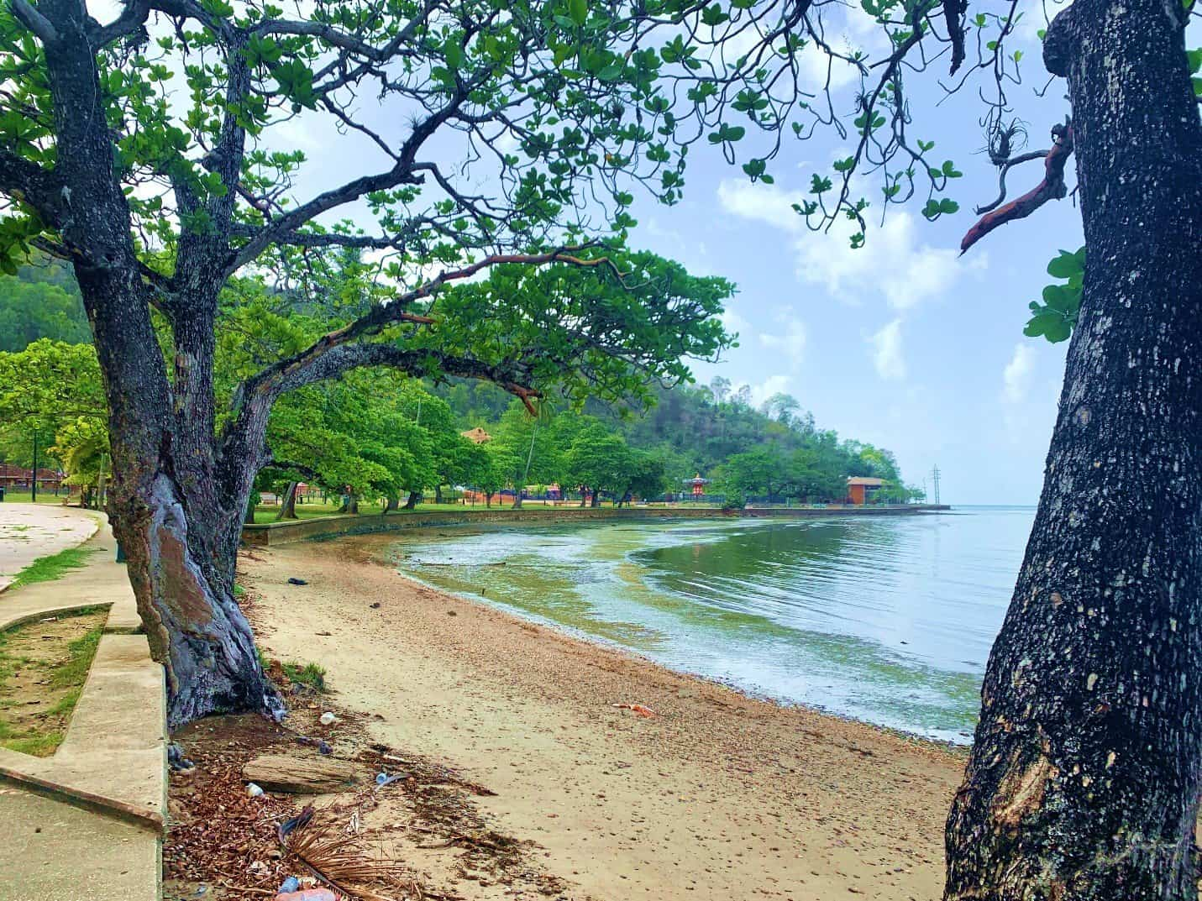
Water Classification
The classification of water bodies in the WCR is generally performed by
Water Use (designated)
  Drinking water supply
  Recreation, bathing
  Support of aquatic life
  Agricultural
  Protected Areas
Water Function
  Receiving waters/Wastewater recipient
  The presence of effluent discharges that could affect the coastal zone must also be considered, along with their capacity for dilution and dispersion

Slide 11
Water Classification in WCR
ANTIGUA AND BARBUDA
BELIZE
The Environment Protection and Management Act
Schedule VII - Water Quality Management Criteria and Guidelines (2019)
Coastal waters are categorised into 3 classes in accordance with the respective uses to be protected
Class AA – remain in natural state
Class A – recreation, support aquatic life
Class B – shipping, industrial activity
The Environmental Protection Act
Effluent Limitation Regulations (2009)
Classification as per LBS Protocol - Class I, Class II

Slide 12
Water Classification in WCR
JAMAICA
SAINT LUCIA
Natural Resources Conservation Authority Act (1991
Natural Resources Conservation (Wastewater and Sludge) Regulations, 2013
Classification as per LBS Protocol - Class I, Class II
Public Health (Water Quality Control) Regulations (1978)
Under the SL Bureau of Standards - Guidelines for Recreational Water Quality (SLNS 83: 2016)
Classification for Class I – recreation in riverine and coastal areas

Slide 13
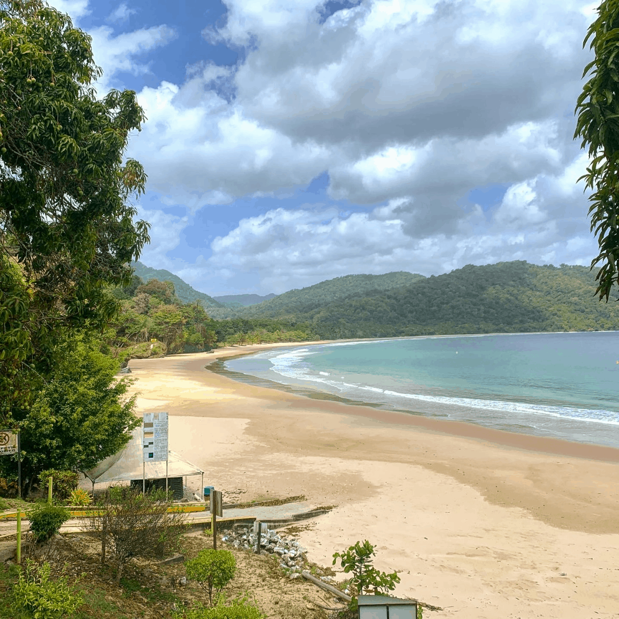
Water Classification in WCR - T&T
Environmental Management Authority (2000)
Water Pollution Rules (2019)
Classification as receiving waters
Environmentally Sensitive Areas
Inland Surface waters
Coastal nearshore
Marine offshore

Slide 14
Water Classification in WCR - USA
Clean Water Act
Water Quality Standards (WQS) Regulations establish the benchmark goals required for all water bodies in the US
Designates uses of US waters and sets the required standards or criteria to protect them
Main uses:
Protection and Propagation of Fish,
Shellfish and Wildlife,
Recreation in and on the water (“fishable/swimmable”)
Additional uses (that consider State waters):
Public Water Supply,
Agriculture and Industry,
Navigation

Slide 15
Water Classification in WCR – USA (FL)
Surface Water Quality Standards - further classified according to water quality criteria
Class I - Potable Water Supplies
Class II - Shellfish Propagation or Harvesting
Class III - Fish Consumption; Recreation, Propagation and Maintenance of a Healthy, Well-Balanced Population of Fish and Wildlife
Class III-Limited - Fish Consumption; Limited Recreation; and/or Propagation and Maintenance of Limited Population of Fish and Wildlife
Class IV - Agricultural Water Supplies
Class V - Navigation, Utility and Industrial Use

Slide 16
Water Classification in WCR –
Colombia
Article 2.2.3.3.2.1 of Decree 1076 (2015) defines the uses for surface or coastal
Human and domestic consumption,
Preservation of flora and fauna, Agricultural,
Livestock, Recreational,
Industry, Aesthetic,
Fishing, Mariculture and Aquaculture, Navigation and Water Transportation
Within this regulation, water bodies are classified with respect to discharges
Class I – (No discharges) Drinking water, recreation, headwaters, protected
Class II – Water bodies that admit discharges with some treatment

Slide 17
Water Classification in WCR
CUBA
DOMINICAN REPUBLIC
Standard for discharge of wastewater in the coastal zone (NC 521:2007)
Class A – Protected areas
Class B – Recreation
Class C – Fishing
Class D – Industrial uses
Class E – Maritime/port activity
Class F – Navigation
Environmental Standard for the quality of surface and coastal waters (NA-CDAS-2012)
Class D2 – preserved in natural conditions, environment
Class E – Conservation of natural resources, recreation
Class F – Water sports no contact
Class G – industrial, port and shipping activities

Slide 18
Water Classification in WCR - Honduras
Environmental General Law of Honduras (Agreement No. 104-93, 1994)
National Regulation for the Discharge and Reuse of Wastewater (Executive Agreement No. 003, 2020)
Classification for natural water bodies according to their uses
Supply to settlements
Conservation of aquatic and coastal flora and fauna
Agricultural and livestock use
Landscape uses
Use in aquaculture
Industrial uses
Recreational uses
Non-drinkable urban uses

Slide 19
Water Classification in WCR
NICARAGUA
PANAMA
General Water Law (Law 620, 2007)
Classification of water bodies, NTON 05007-98
Type 1 – Domestic and industrial use that requires drinking water
Type 2 – Agricultural use
Type 3 – Shellfish propagation
Type 4 – fishing, recreation
Type 5 – Industrial use
Type 6 – Navigation and power
Environmental quality standards for natural waters (Draft Decree, 2007)
Class 1M – Conservation of aquatic communities, recreation (direct), aquaculture and fishing
Class 2M – Protection of aquatic communities, recreational fishing
Class 3M – Navigation

Slide 20
Water Classification in WCR - Venezuela
Rules for the Classification and Quality Control of Water Bodies and Liquid Discharges or Effluents (Decree No 883)
Type 1 - Domestic and industrial use that requires drinking water,
Type 2 - Agricultural uses.
Type 3 - Breeding of molluscs consumed raw.
Type 4 - Beaches, water sports, sport, commercial and subsistence fishing.
Type 5 - Industrial uses that do not require drinking water.
Type 6 - Navigation and power generation.
Type 7 - Transport, dispersion and breakdown of pollutants without causing interference with the adjacent environment

Slide 21
Water Classification in the WCR
COUNTRY | LEGISLATION | CLASSIFICATION
 |  | CLASS I | CLASS II
Colombia | Decree 1076 (2015) | According to uses: Type: 2, 5, 7 and 8 Regarding discharges: Class I | According to the uses: Type 6 and 9 Regarding discharges: Class II
Cuba | NC 521 (2007) | Class A, B and C | Classes D, E and F
Dominican Republic | NA-CACS (2012) | Class D2 and E | Class F and G
Honduras | Executive Agreement 003 (2020) | Types B, E and G | Type C, D, F and H
Nicaragua | NTON 05007 -98 (2000) | Type 3 and 4 | Type 5 and 6
Panama | Draft Decree (2007) | Class 1M, 2M | Class 3 M
Venezuela | Decree 883 (2005) | Types 3 and 4 | Types 5, 6 and 7

Slide 22
Water Classification in the WCR
COUNTRY | LEGISLATION | CLASSIFICATION
 |  | CLASS I | CLASS II
Antigua & Barbuda | Schedule VII, Environmental Protection and Management Act (2019) | Coastal Waters - Class AA (propagation marine life, natural state, no discharge), Class A (recreation, highest level treatment) | Class B (ports, industrial, maximum discharge control)
Belize | Effluent Limitation Regulations 2009 Amendment | Class I | Class II
Jamaica | Natural Resources Conservation (Wastewater and Sludge) Regulations, 2013 | Class I | Class II
Saint Lucia | SLNS 2016 Guidelines for Recreational Water Quality | Recreational Waters
Trinidad & Tobago | Water Pollution Rules (2019), Environmental Management Act, 2000 | Environmentally Sensitive Areas, Inland Surface Waters, Coastal Nearshore | Marine Offshore
USA – Florida | Clean Water Act - Water Quality Standards | Class I (potable) , Class II (shellfish propagation), Class III (recreation), Class III-limited (fish consumption) | Class IV (Agri water supplies), Class V (Navigation, Industrial use)
Puerto Rico (US Territory) | Puerto Rico Water Quality Standards Regulation (PRWQSR) | Class SA, Class SB, Class SE
US Virgin Islands (US Territory) | US Virgin Islands Water Quality Standards Regulations | Class A, Class B | Class C

Slide 23
Water Classification in WCR
These countries have existing legislative elements but do not yet have an established system
The Bahamas
Barbados*
Grenada
Guyana
Costa Rica
Guatemala
Mexico

Slide 24
Water Classification in WCR
13 countries (65%) currently categorise waters in coastal nearshore and marine areas
Only Belize and Jamaica (20%) have included the water classification of Annex III within their existing legislation
All countries with classification systems are generally compatible or aligned with the LBS Protocol
English speaking countries with water classification systems and all Spanish speaking countries have regulations that define discharge limits of water/environmental quality indicators

Slide 25
Water Classification in other Regions - The Philippines
Classification | Intended Beneficial Use
CLASS SA | 1.Protected Waters – Waters designated as national or local marine parks, reserves, sanctuaries and other areas established by law (Presidential Proclamation 1801 and other existing laws), and/or declared as such by appropriate government agency, LGUs, etc.
 | 2.Fishery Water Class I – Suitable for shellfish harvesting for direct human consumption
CLASS SB | 1. Fishery Water Class II – Waters suitable for commercial propagation of shellfish and intended as spawning areas for milkfish and similar species 2. Tourist Zones – For ecotourism and recreational activities 3. Recreational Water Class I – Intended for primary contact recreation (bathing, swimming, skin diving, etc.)
CLASS SC | 1. Fishery Water Class III – For the propagation and growth of fish and other aquatic resources and intended for commercial and sustenance fishing 2. Recreational Water Class II – For boating, fishing or similar activities 3. Marshy and/or mangrove areas declared as fish and wildlife sanctuaries
CLASS SD | Navigable waters
The Philippine Clean Water Act (PCWA) of 2004 (Republic Act 9725)
Water Quality Guidelines and General Effluent Standards in 2016 (DENR Administrative Order 2016-08)
Water body usage and classification of marine waters
These water quality guidelines are continually used to categorise waters according to their quality, area, purpose and vulnerability to pollution.

Slide 26
Water Classification in other Regions - South Africa
National Water Act of South Africa (1998)
National Water Act Regulations, 2010
Established of a water resource classification system to ensure ecological sustainability with consideration of all needs, social and economic of significant water resources
Class I - Waters that are minimally used and the configuration of ecological categories of the water resources within a catchment result in an overall water resource condition that is minimally altered from its pre-development condition.
Class II - Waters that are moderately used and the configuration of ecological categories of the water resources within a catchment result in an overall water resource condition that is moderately altered from its pre-development condition.
Class III - Waters that are heavily used and the configuration of ecological categories for the water resources within a catchment result in an overall water resource condition that is significantly altered from its pre-development condition

Slide 27
PROPOSED GUIDELINES FOR WATER CLASSIFICATION
General guidelines in order to classify coastal-marine water bodies with a focus on the LBS Protocol in the following areas:
LEGISLATION
Development of new and/or updating existing policy framework
Incorporate LBS Protocol (Annex III) into environmental legislation
Establish Regulations inclusive of water quality standards related to water classification
EFFLUENT LIMITATIONS
Establish Effluent Limitation Regulations to supplement the environmental legislation
Discharge (maximum permissible) limits for environmental/water quality indicators
Potential revision/update of the standards or criteria for discharges

Slide 28
PROPOSED GUIDELINES FOR WATER CLASSIFICATION
General guidelines in order to classify coastal-marine water bodies with a focus on the LBS Protocol in the following areas:
CRITERIA FOR CLASSIFICATION OF WATER BODIES
Focus on conservation and/or minimizing the environmental impact of discharges.
Consideration of existing factors such as current state of coastal zone and corresponding watershed
Wastewater recipients must maintain water quality of designated class in accordance with the existing effluent/wastewater discharge standards.
MONITORING AND REHABILITATION
Monitoring programme should be implemented to ensure preservation of all designated classes.
Avoid classifying an ecosystem as "irrecoverable” based on current use/water quality status
A recovery program should be developed for waters of depleted quality to progressively become fit for purpose.

Slide 29
Recommendations for Consideration of the Parties
Establish roadmap for classification of waters
Clearly identify the designated uses of coastal waters
Include/ reference effluent regulations for conservation, protection and designated uses of coastal waters in environmental legislation .
Improve relationship between water classification and discharge (maximum permissible) limits of key environmental indicators/effluent parameters.

Slide 30
Recommendations to STAC
The Secretariat with the support of the LBS RACs conduct further studies to assess the effectiveness of regulatory implementation of national water classification schemes and encourage Member States to report on their implementation experiences. The study should document the methodologies used to delineate areas of different classes of waters in the Convention area and how the national classification schemes align with the LBS Protocol's Classs I and Class II waters.
Contracting Parties endorse the proposed guidelines for classifying waters according to the LBS Protocol as defined under UNEP(DEPI)/CAR WG.44/INF.16 Rev.1 and agree to consider the outlined principles when classifying marine and coastal waters moving forward.

Slide 31




Thank You

